Slide 1
SUMMER INTERNSHIP REPORT
P
Car Parking Management System
A Java Full Stack web application built at Fantasy Solution
Keerthana R – 810023205068
Department of Information Technology
University College of Engineering (BIT Campus), Anna University, Tiruchirappalli
Notes:
Introduce the project: a full-stack car parking management system developed during the June 2026 internship at Fantasy Solution.

Slide 2

Company Profile: Fantasy Solution
An IT services company delivering web applications, software solutions and technical training for students and fresh graduates.
Industry
IT Services & Software Development
Services
Web & mobile apps, database design, REST APIs, testing, training
Technologies
Java, Spring Boot, HTML, CSS, JavaScript, Bootstrap, MySQL
Trichy, Tamil Nadu
Software Development & Training
Tools
Eclipse, IntelliJ IDEA, VS Code, Maven, Git & GitHub
Notes:
Fantasy Solution, Trichy. Internship: Full Stack Development, 01 June to 30 June 2026.

Slide 3
Internship at a Glance
30
6
3
1
days
core modules
tier architecture
live web app
01 – 30 June 2026
Login to Admin
UI · Spring Boot · MySQL
Driver + Admin portals
Objectives
Secure registration and login for drivers and admins
Real-time view of available, occupied and reserved slots
Online slot booking with vehicle and payment records
Reduce manual errors, slot conflicts and waiting time
Notes:
The internship ran for 30 days with daily milestones from requirement gathering to testing.

Slide 4
From Manual Parking to a Digital System
Existing System
Proposed System
Slots allocated manually by staff
No real-time slot availability
Paper registers and scattered records
Queues and longer waiting at peak hours
Limited admin visibility and reports
Centralised web platform with MySQL
Live view of available, occupied, reserved slots
Online booking, vehicle and payment records
Double-booking prevented by availability check
Admin dashboard with users, bookings, reports
Notes:
Contrast manual register-based parking with the proposed centralized system.

Slide 5
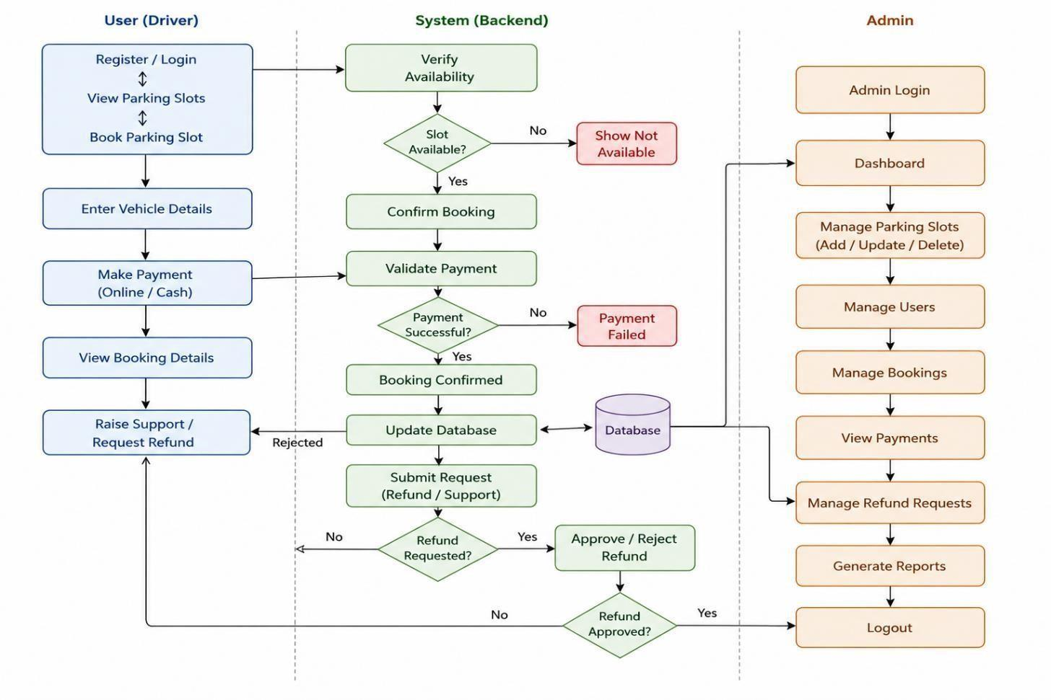
System Architecture & Workflow
Presentation Layer
HTML5, CSS3, JavaScript, Bootstrap 5
Business Logic Layer
Spring Boot, REST APIs, authentication
Database Layer
MySQL: users, slots, bookings, payments
Notes:
Three-tier architecture. The block diagram shows driver, backend and admin flows: availability check, payment validation, booking confirmation.

Slide 6
Core Modules
1
2
3
User Authentication
Parking Slot Management
Vehicle Management
Registration, login, role-based access
Add, update, delete; live status
Vehicle number, type, model; entry and exit
4
5
6
Booking Management
Payment Management
Admin Management
Reserve slots, view booking history
Fees, transaction status, records
Users, bookings, payments, reports
Notes:
Six modules implemented as Spring Boot controllers, services and repositories.

Slide 7
Slot Booking Logic
1
Driver logs in and opens the slot section
ParkingService.bookParking()
slot = slotRepository
.findById(booking.getSlotId())
.orElseThrow(NotFound);
if (slot.getStatus()
.equals("OCCUPIED"))
throw new RuntimeException(
"Slot Already Occupied");
slot.setStatus("OCCUPIED");
booking.setBookingStatus(
"CONFIRMED");
2
System lists available slots
3
Driver selects a slot and enters vehicle details
4
System verifies the slot is not occupied
5
Booking is created and slot marked occupied
6
Payment confirms the booking
Notes:
Walk through the algorithm; availability check prevents double booking.

Slide 8
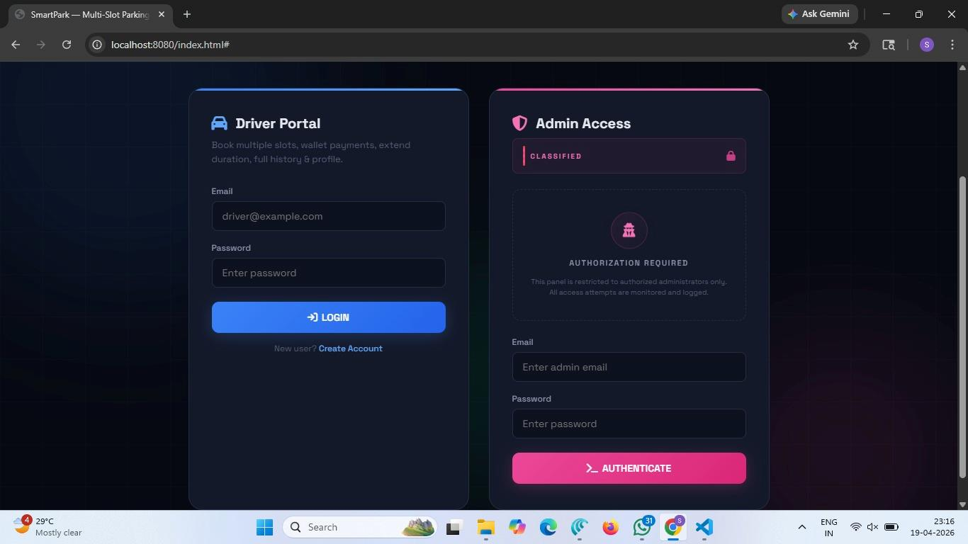
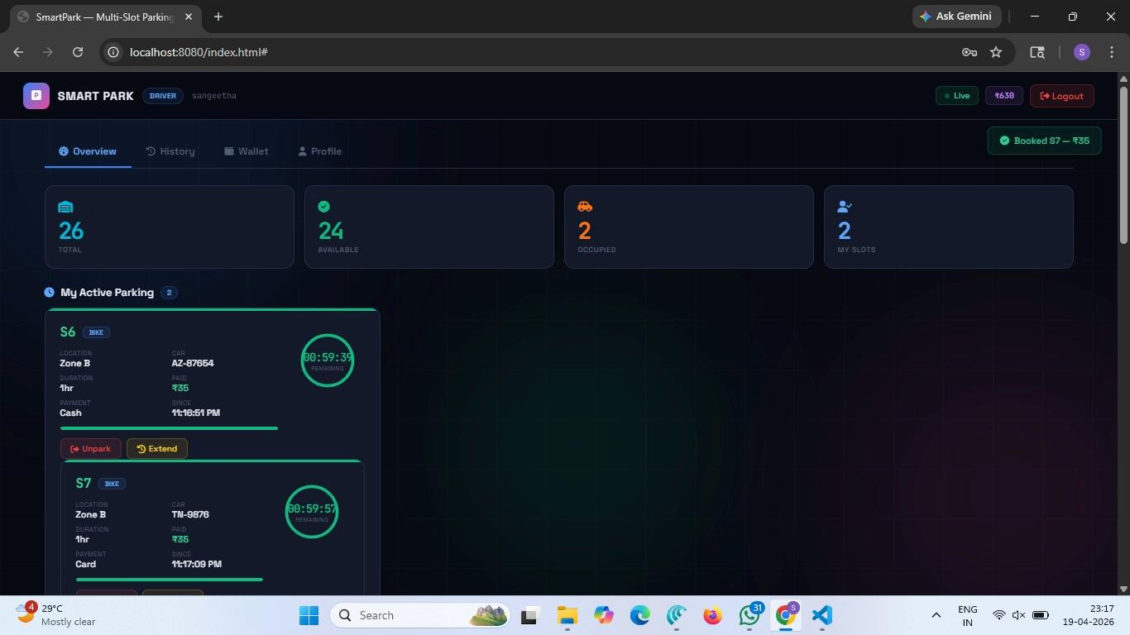
Sample Output: Login & Driver Dashboard
Home page
Separate Driver Portal and Admin Access with secure login.
Customer dashboard
Slot counts, active parking with live timers, payments and history.

Slide 9
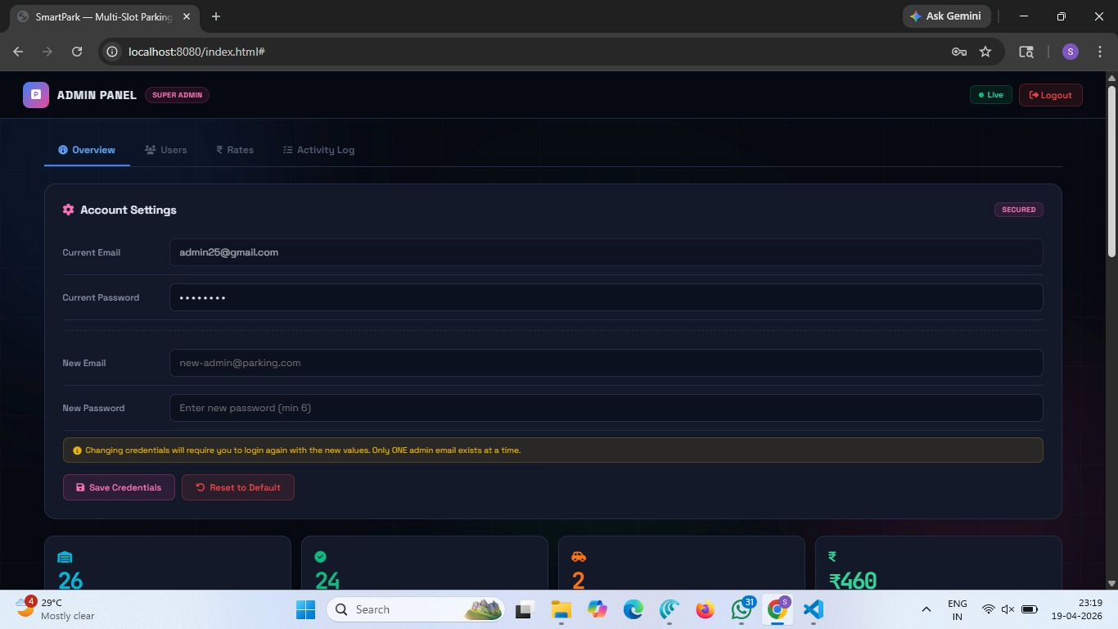
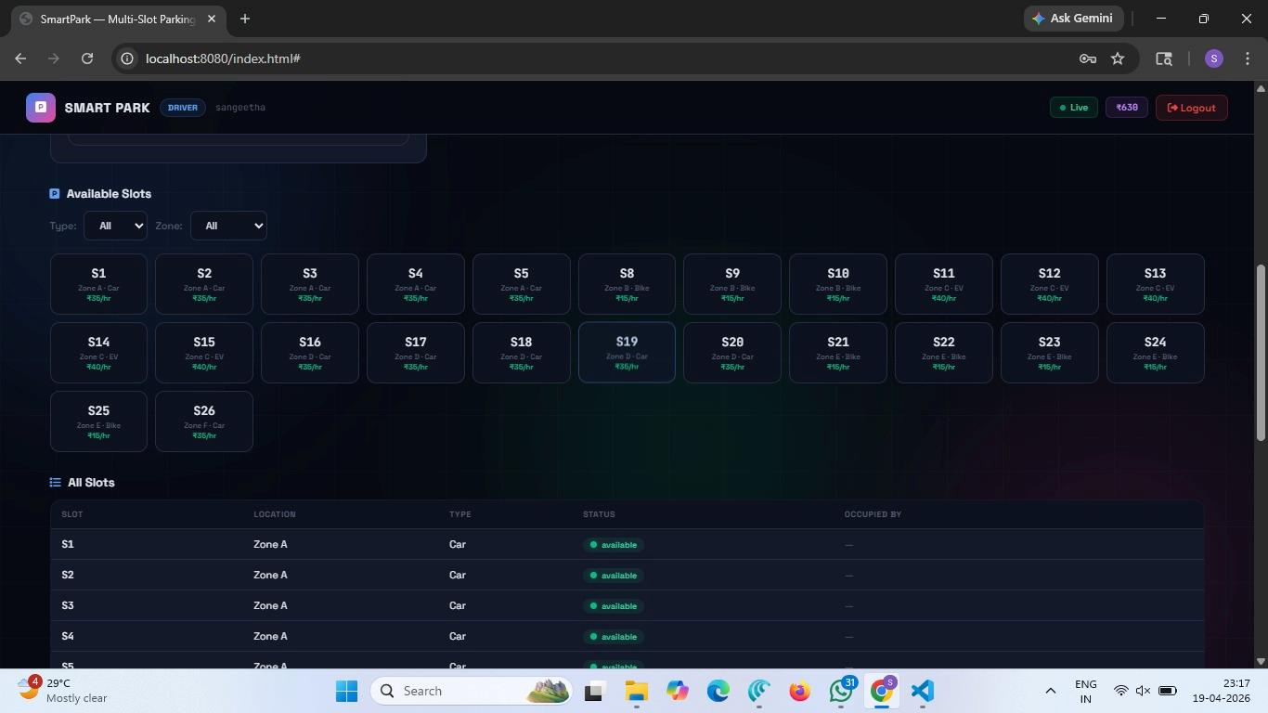
Sample Output: Admin Panel & Slot Status
Admin dashboard
Manage users, rates, slots and monitor revenue and activity.
Slot management
All 26 slots with zone, type and live availability status.

Slide 10
Conclusion & Future Work
What was achieved
Future enhancements
Digitised slot booking, vehicle and payment handling
Layered Spring Boot + REST architecture
Hands-on SDLC, API and database experience
Razorpay / Stripe payment gateway
QR entry/exit and number plate recognition
IoT sensors and mobile app
JWT security and cloud deployment
Thank you

